Slide 1
Jamie Research Progress
Professor Bobby Bodenheimer LiVE lab

Slide 2
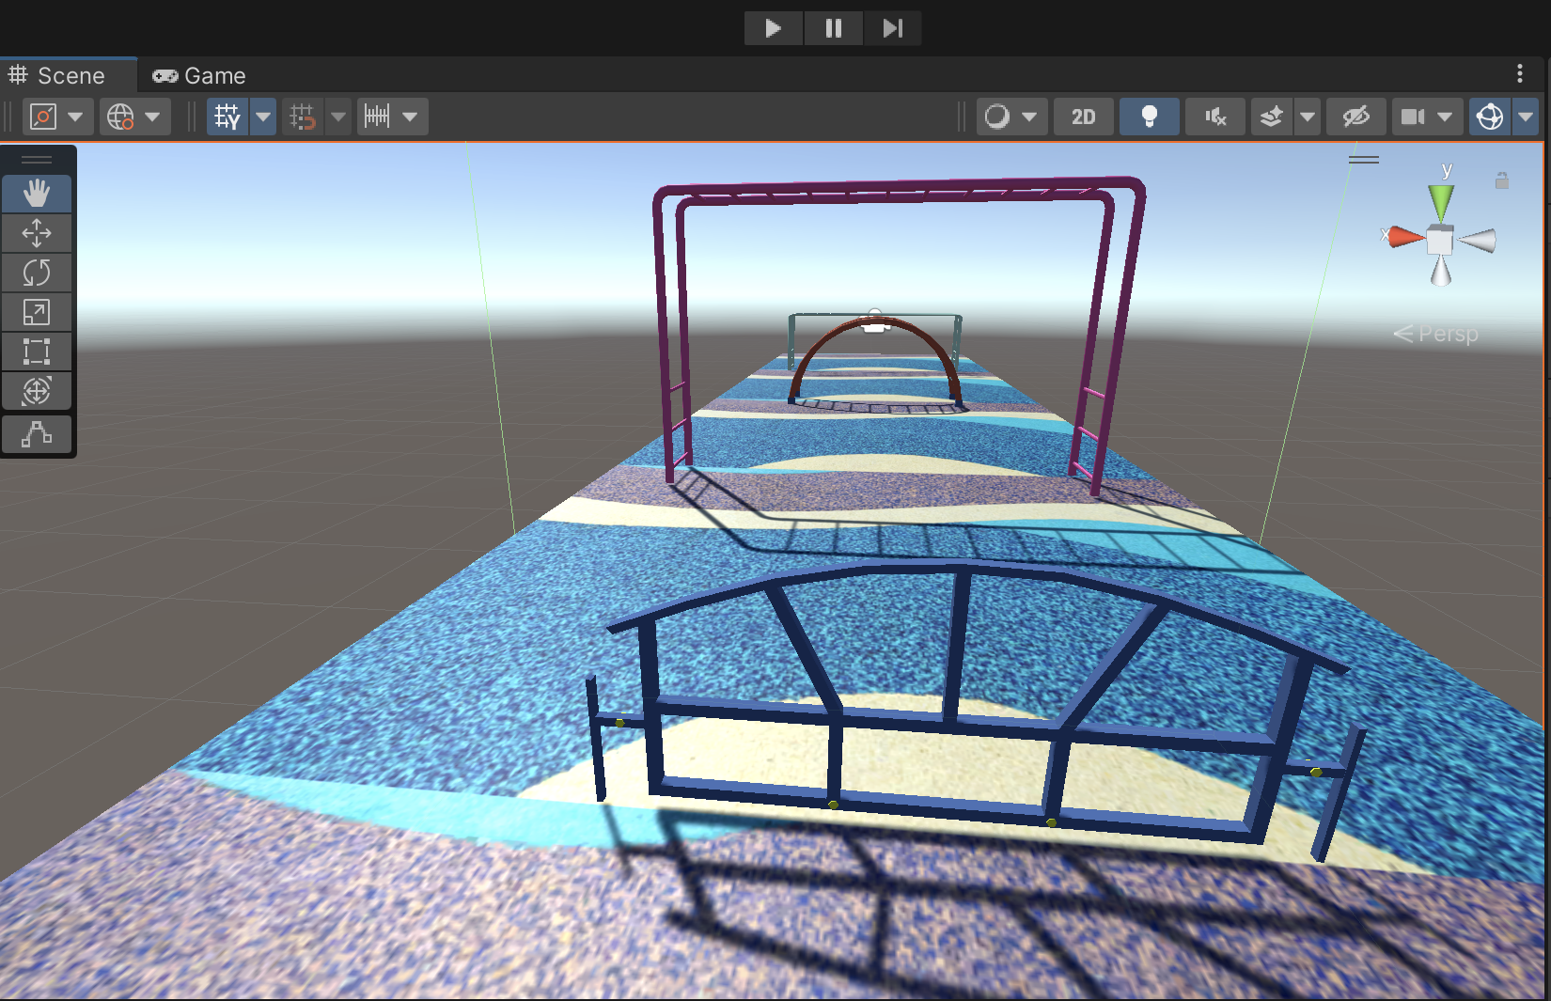
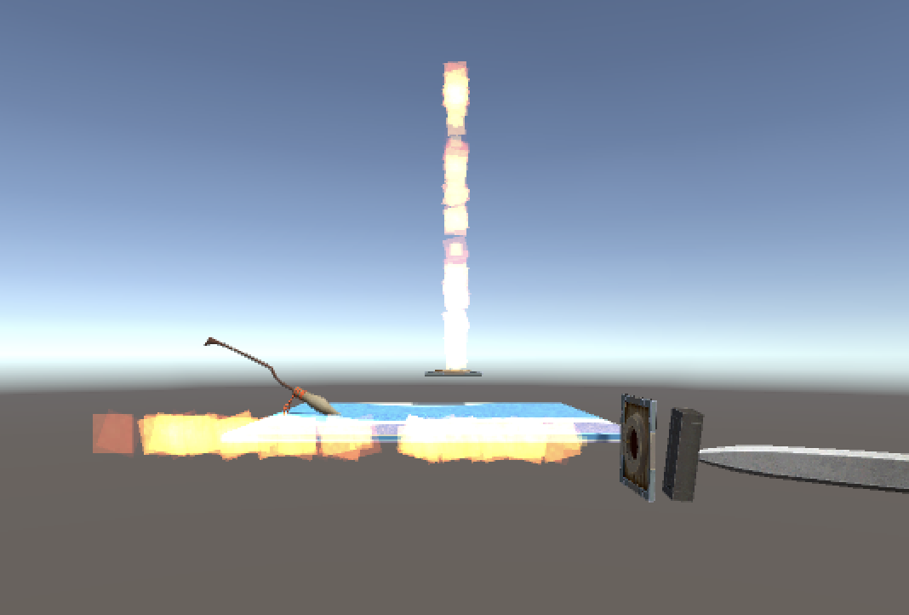
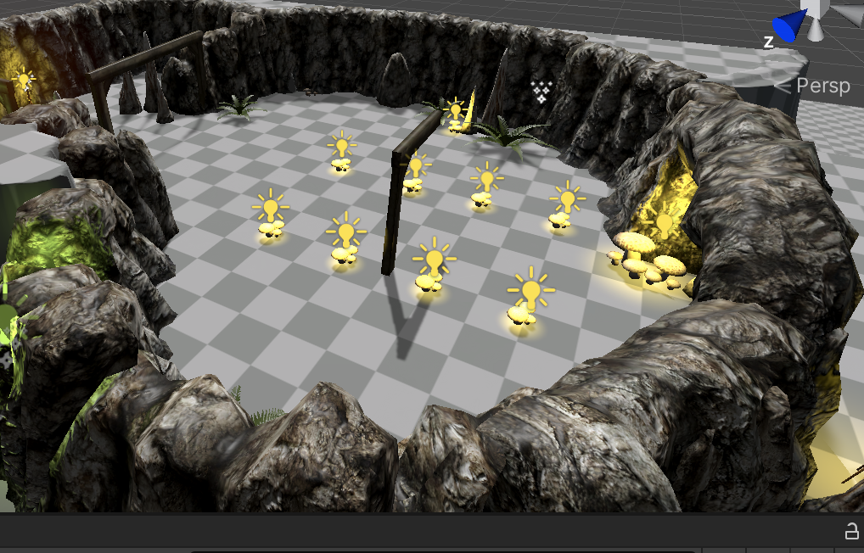
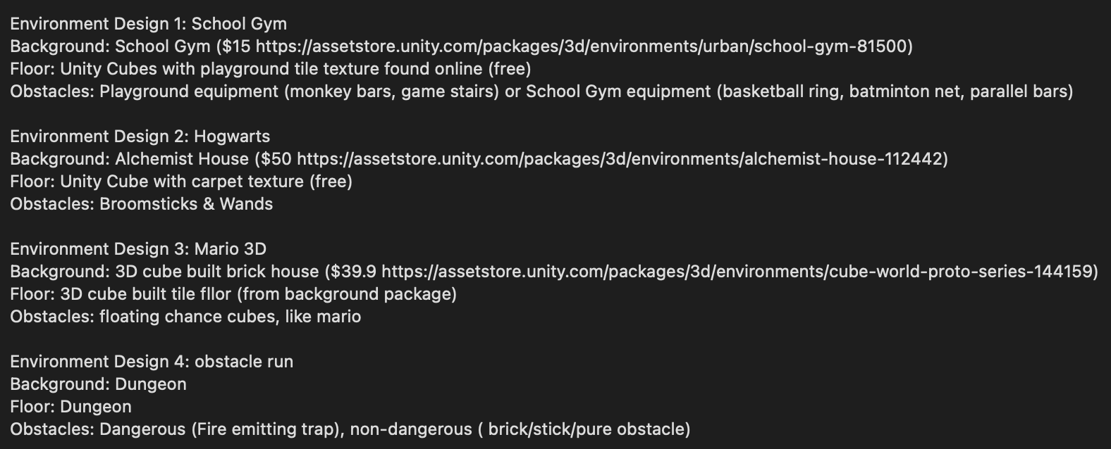
June 17 – June 23
Environment Design
Asset Finding and Exploration
Basic XR Setup tutorials https://www.youtube.com/watch?v=gGYtahQjmWQ
Initial Building of Experimentation environment
On going: Paper reading

Slide 3
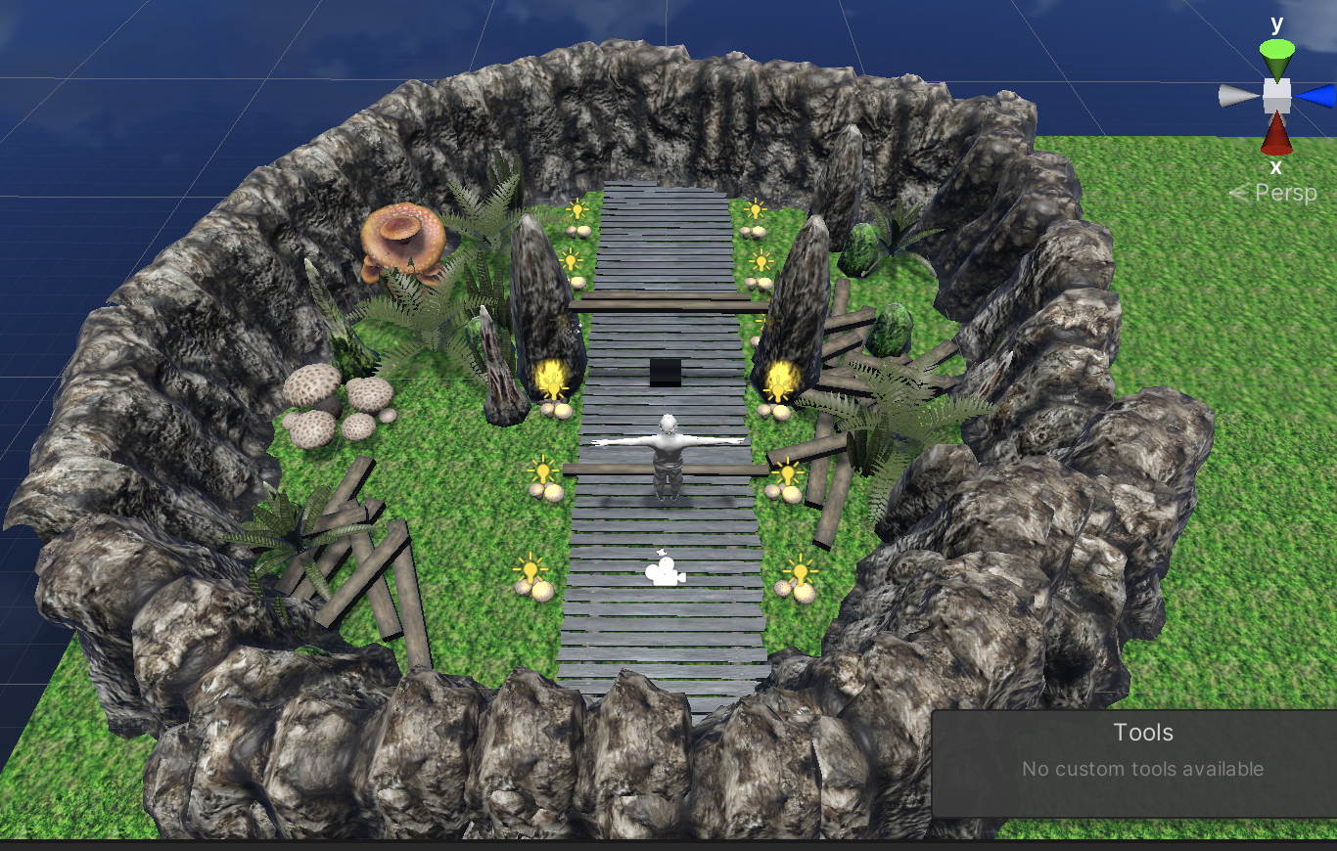
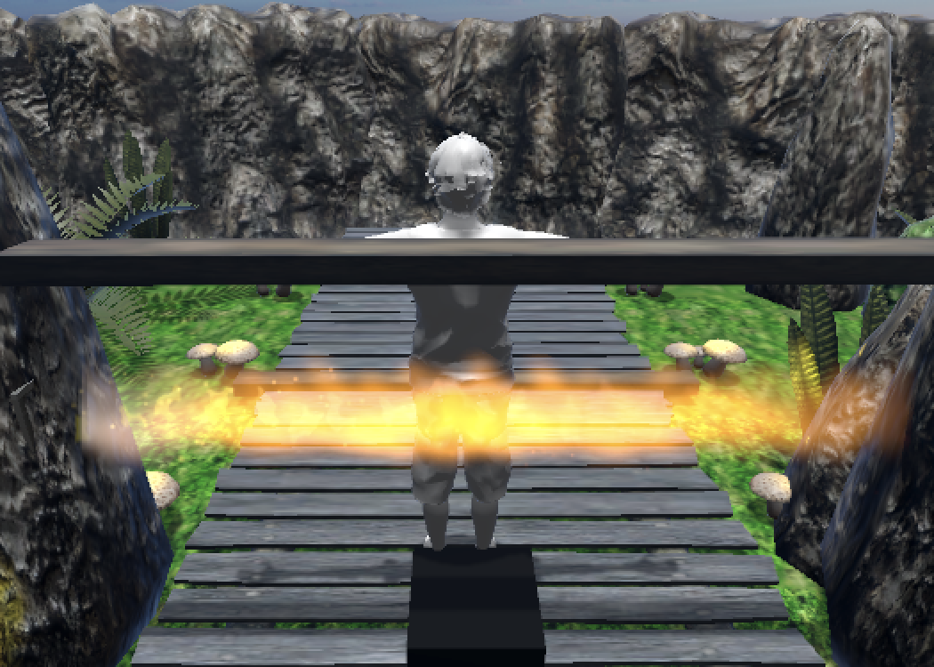
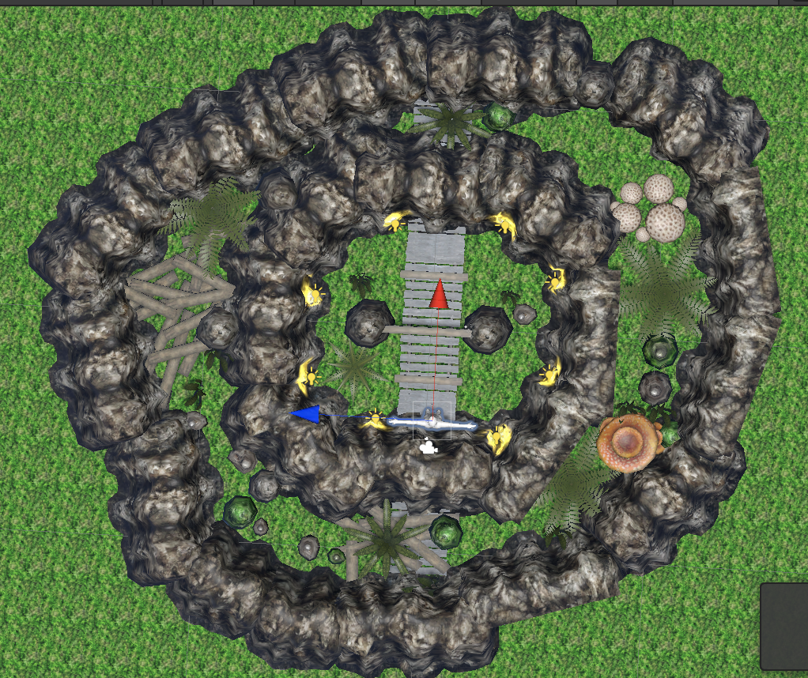
Jun 24 – Jun 29
Finish setting enviornment
Adjust scale and position
Add avatar and simple camera movement
Scripting + Experimental Design

Slide 4
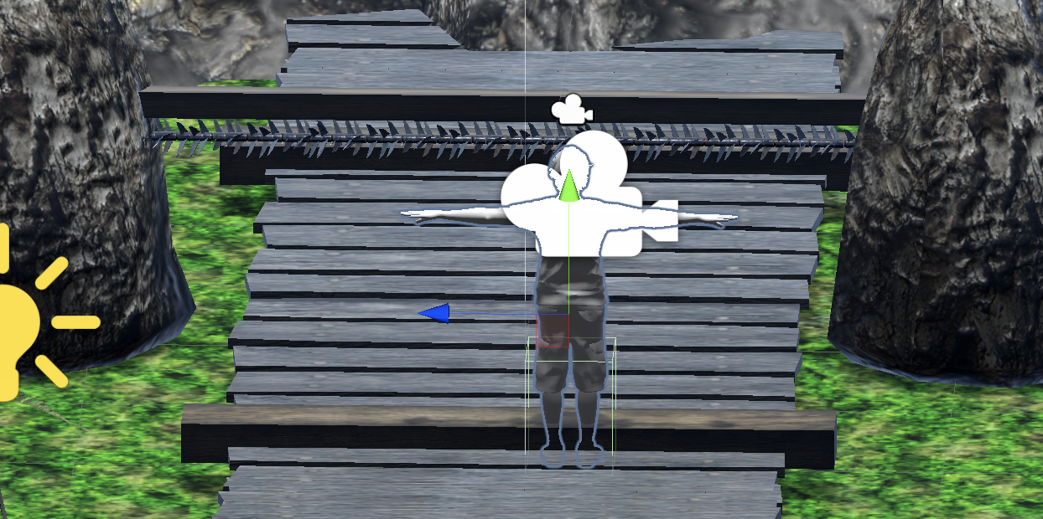
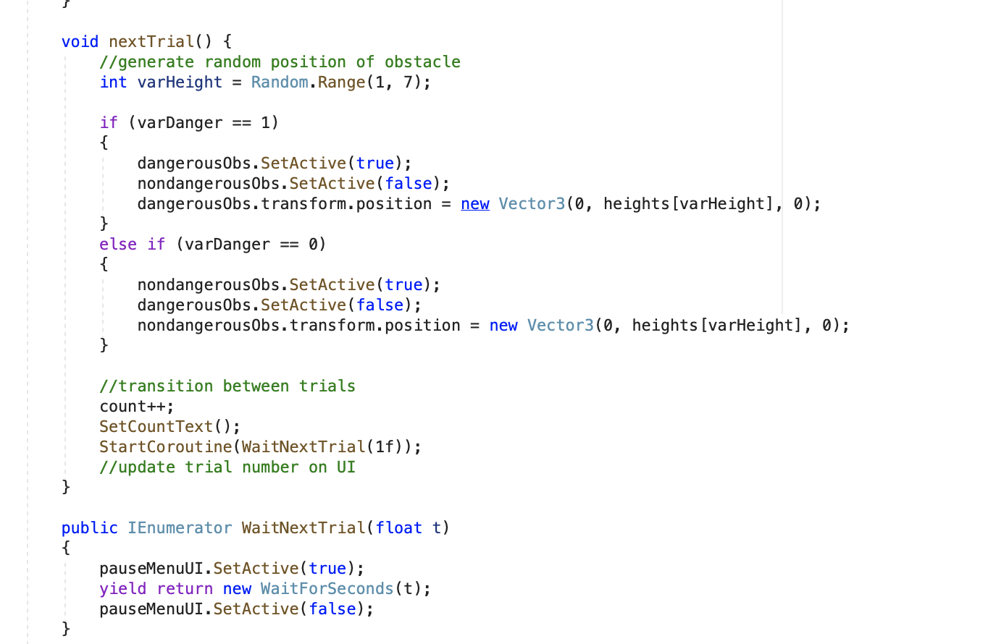
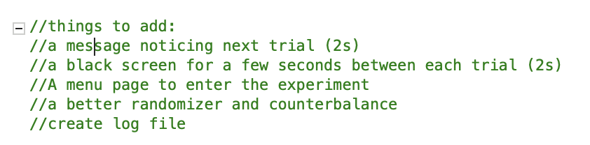
June 30 – July 7
XR Toolkit & Import to Vive
Finalize Environment & Finalize dangerous obstacle
Preliminary Scripting for trials
Piolet Experiment for Soumya
On going: Paper reading

Slide 5
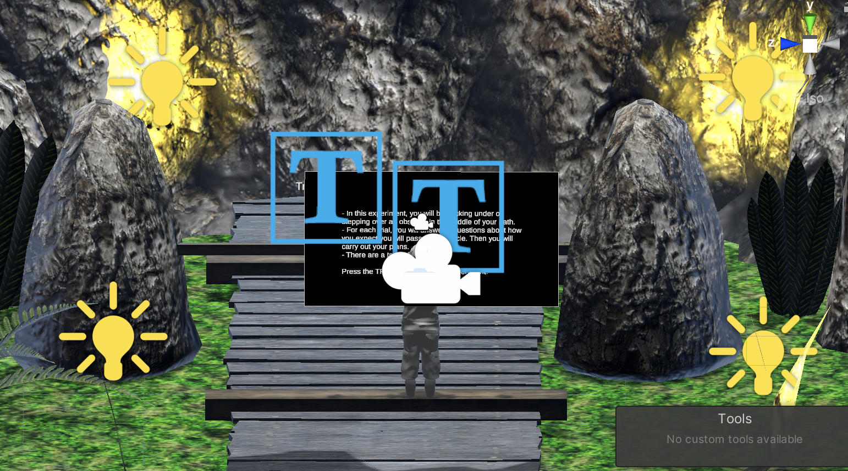
July 8 – July 14
Scripting for Trials & vive testing
Final adjustments of the Obstacles
UI between trials
On going:
Testing Height conditions
Confirm Data Collection Methods
log files
Solve trigger problems
Adjust UI
Employ avatar

Slide 6
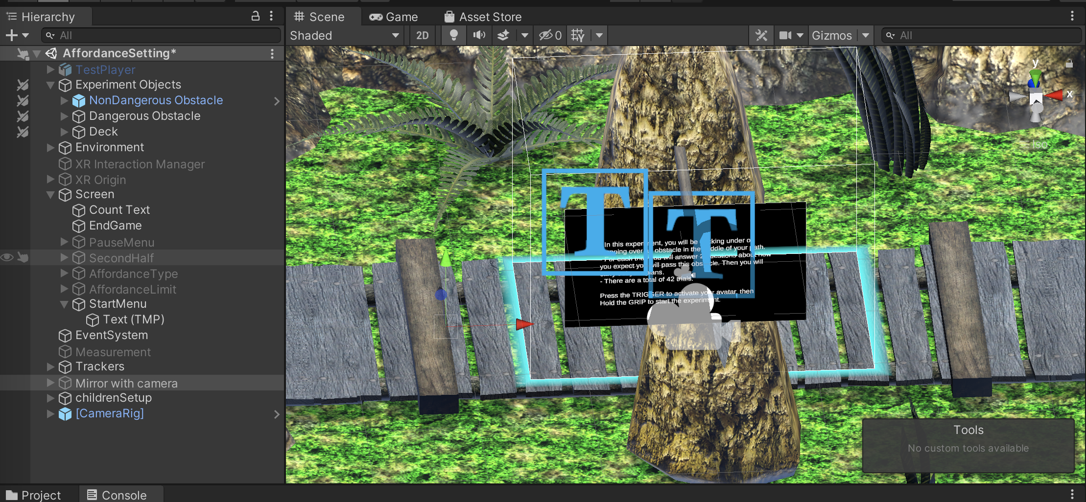
July 15 – July 21
Continued with Scripting:
Almost finalized UI
Finished trigger and menu sequence
Imported Avatar
Next:
Adjust Avatar
Log file
Experiement protocal, variable increments, design specifics
Finalize environment

Slide 7
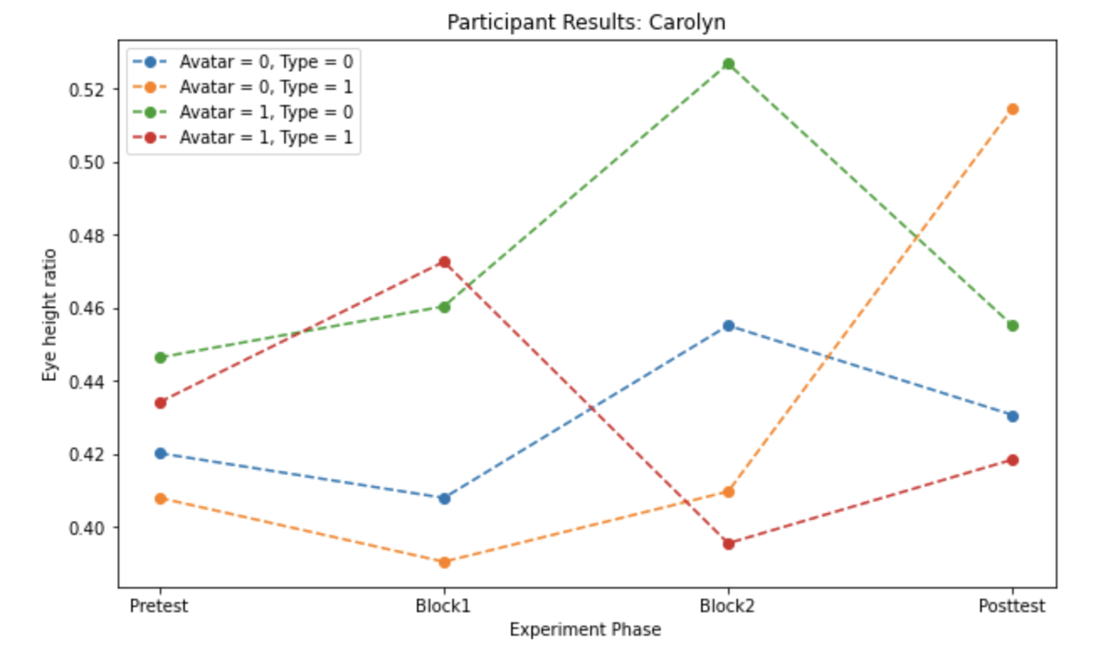
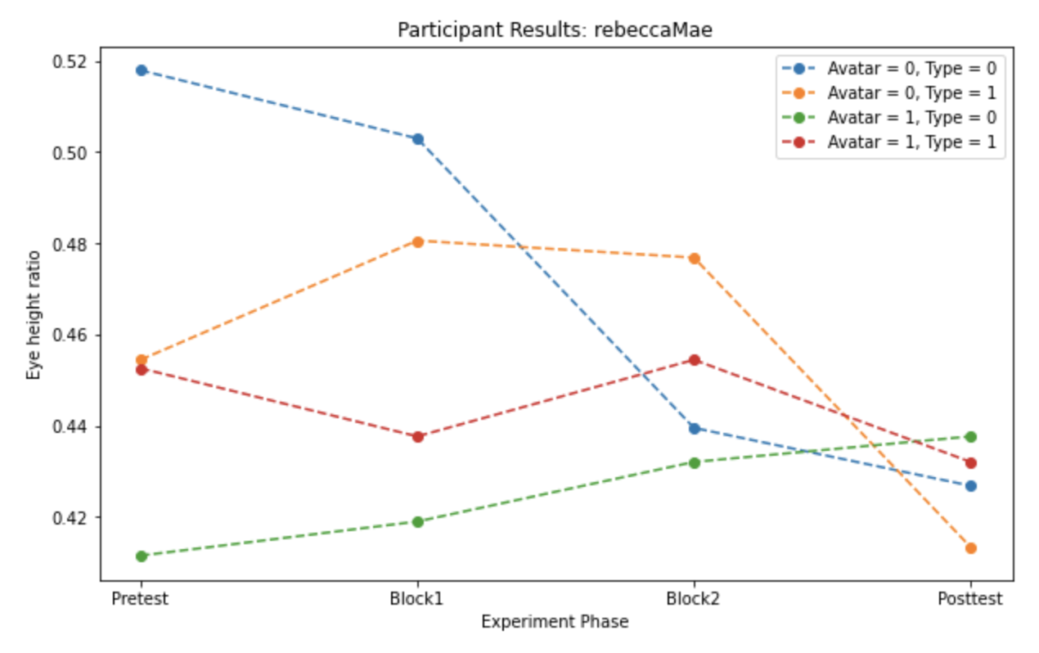
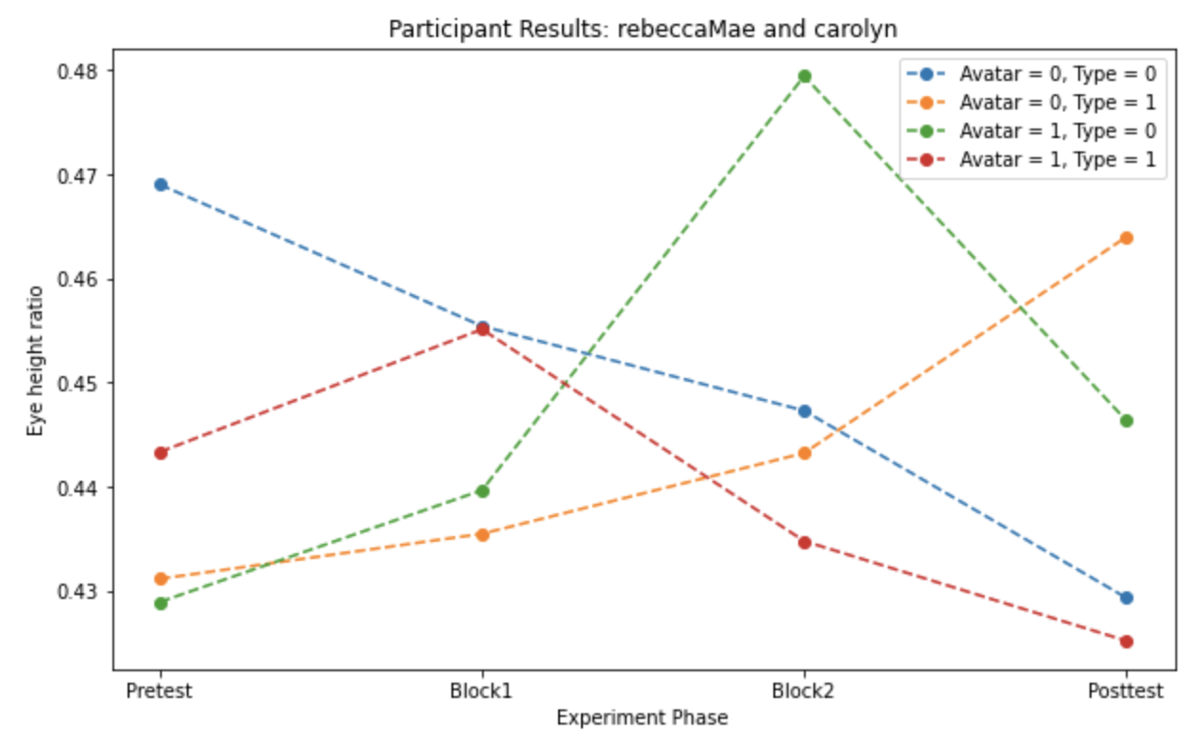
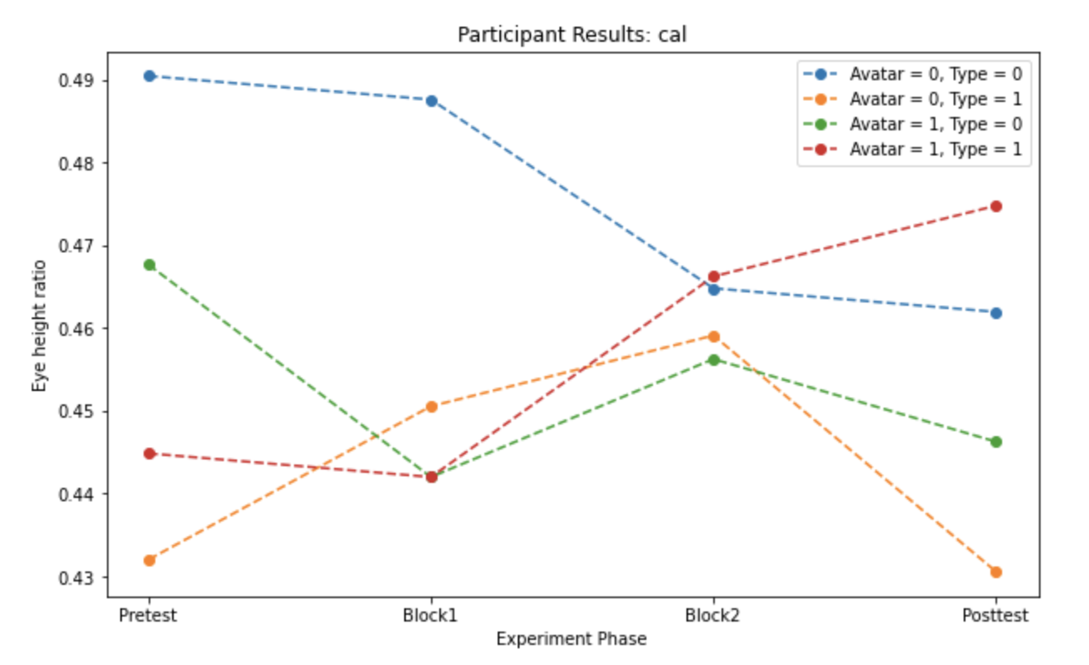
Pilot Results

